Slide 1
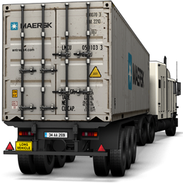
openSUSE 12.1
What comes around!
Rauhmaru (rauhmaru@opensuse.org)

Slide 2

Your name
Your nick
what do you do?
your@email.org
Notes:
Apresentação

Slide 3

Agenda
Release schedule
What we have now?
News
Window managers
  GNOME
  KDE
  LXDE
  XCFE
YaST
Communication channels

Slide 4

openSUSE 12.1
What we have now?

Slide 5
Release schedule openSUSE 12.1
Tue, May 31 2011, openSUSE 12.1 Milestone 1 release
Wed, Jun 22 2011, openSUSE 12.1 Milestone 2 release
Thu, Jul 14 2011, openSUSE 12.1 Milestone 3 release
Thu, Aug 11 2011, openSUSE 12.1 Milestone 4 delayed
Thu, Sep 01 2011, openSUSE 12.1 Milestone 5 release
Thu, Sep 22 2011, openSUSE 12.1 Beta
Thu, Oct 13 2011, openSUSE 12.1 RC 1
Fri, Oct 27 2011, openSUSE 12.1 RC 2
Thu, Nov 03 2011, openSUSE 12.1 Goldmaster
Fri, Nov 11 2011, openSUSE 12.1 Public Release
  Codename Asparagus

Slide 6

How to get!
Version 12.1 (Devel)
http://software.opensuse.org/developer/
Version 11.4
http://software.opensuse.org/
Avaliable for download:
  Direct link
  BitTorrent
  Metalink

Slide 7
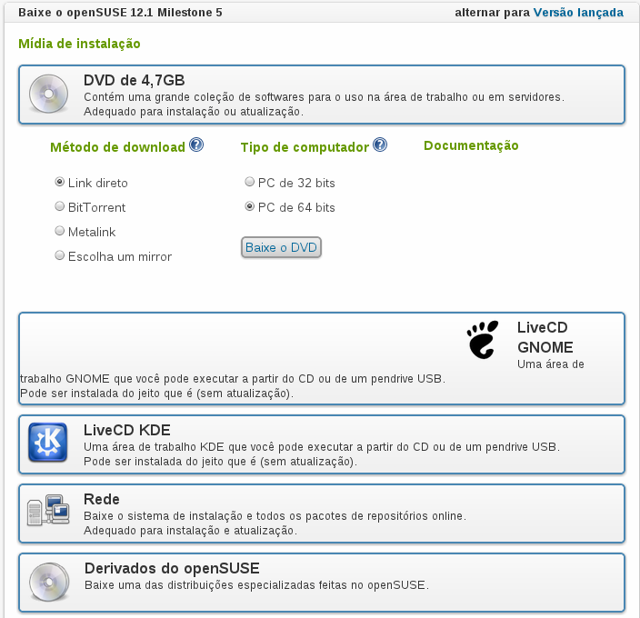

Slide 8

And what we have there?
Stability
  Kernel 3.1
Window manager
  GNOME?
  KDE?
  LXDE?
  XFCE?

Slide 9
Under the hood
Systemd – Proposes to initiate fewer processes and start more processes in parallel
Dracut - Supposed to replace MKinitrd, the tool that generates the initial bootup images of the kernel (which are loaded by the bootloader).
Grub2 – Expected stability in 12.1

Slide 10

GNOME
GNOME 3.2
Much more mature!
Now with YaST!
Many updates!!!
Addition a document interface for Activities Summary
Expansion of application menus on the top bar
Integrated environments for document sharing and web accounts.

Slide 11
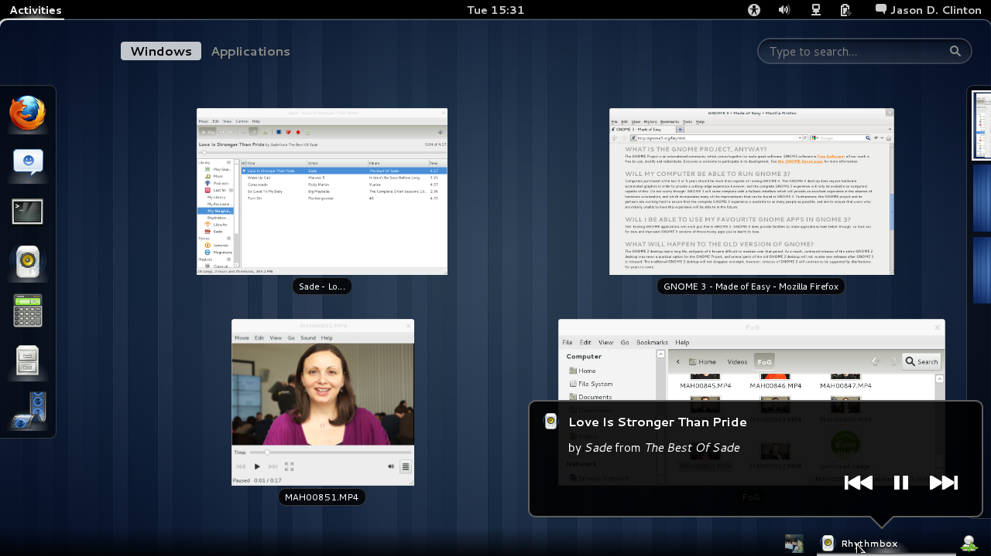
Rhythmbox

Slide 12
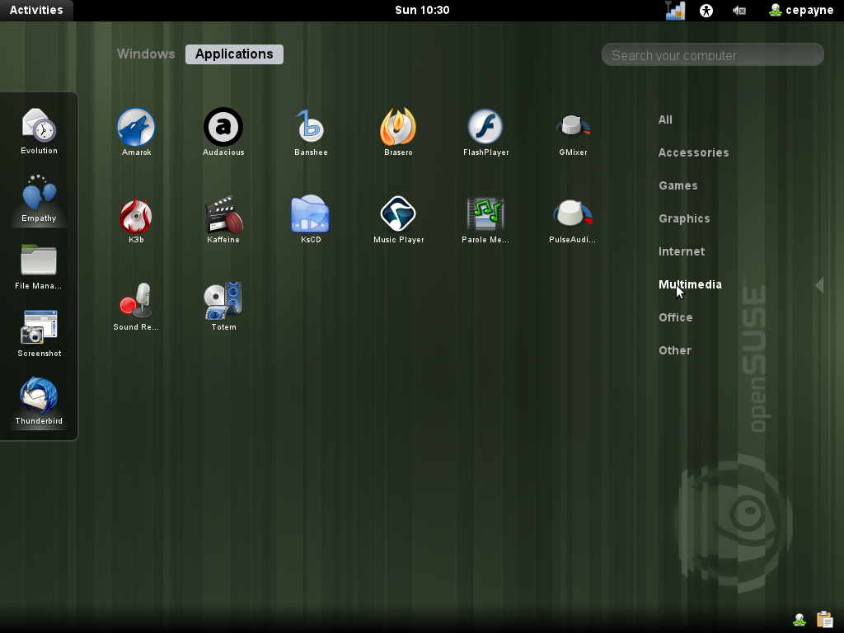

Slide 13
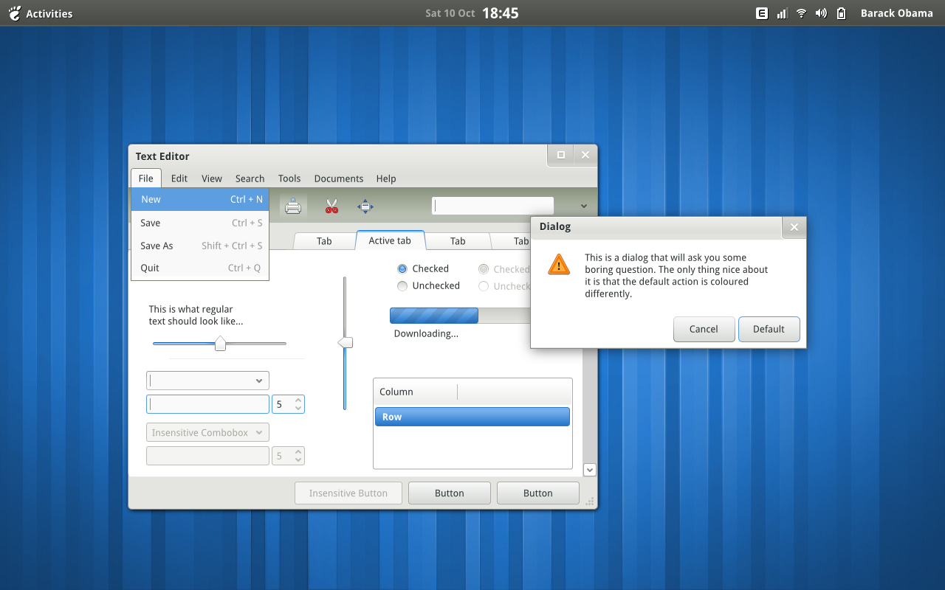

Slide 14
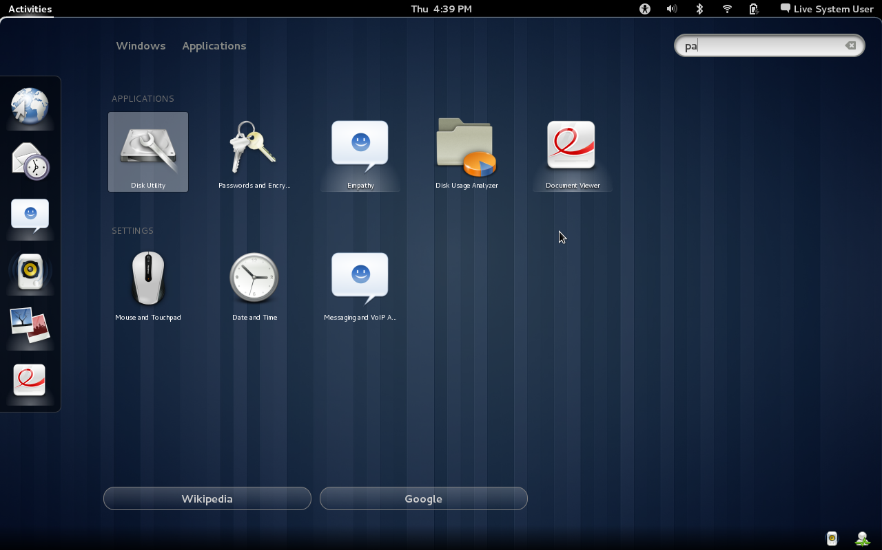

Slide 15
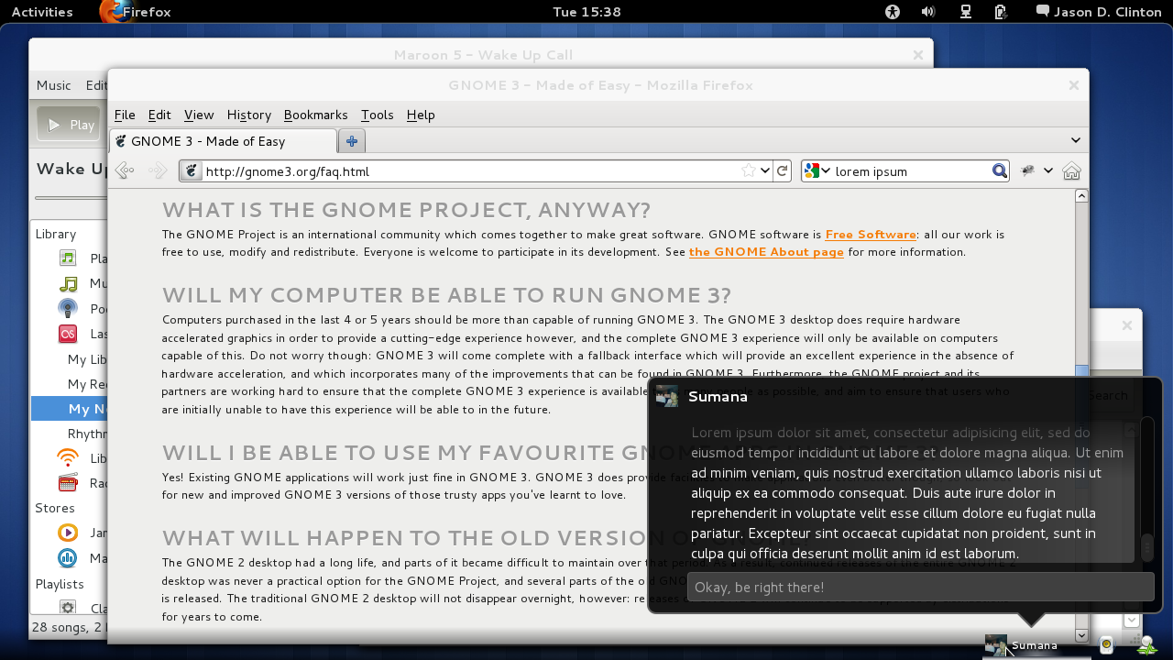
Empathy integration

Slide 16
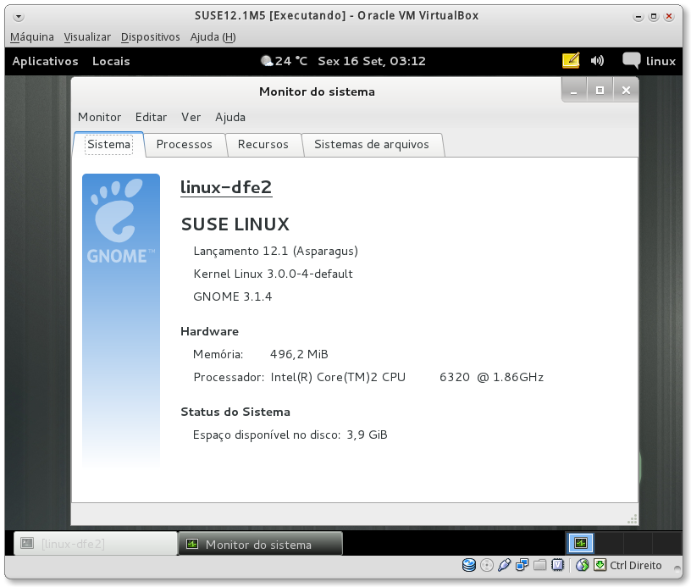

Slide 17
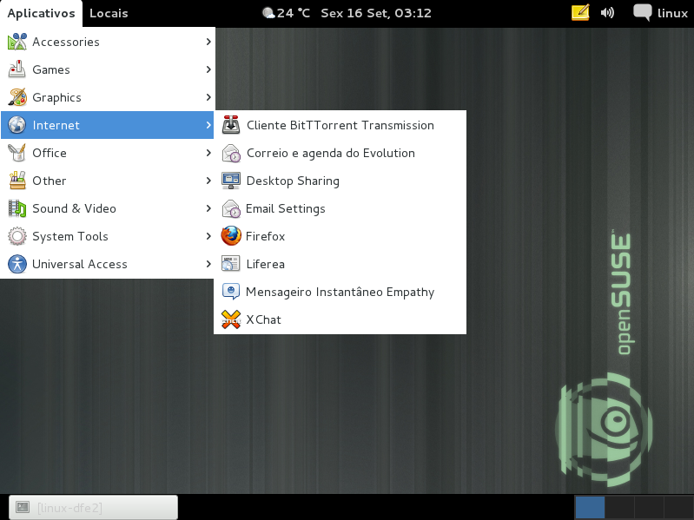

Slide 18
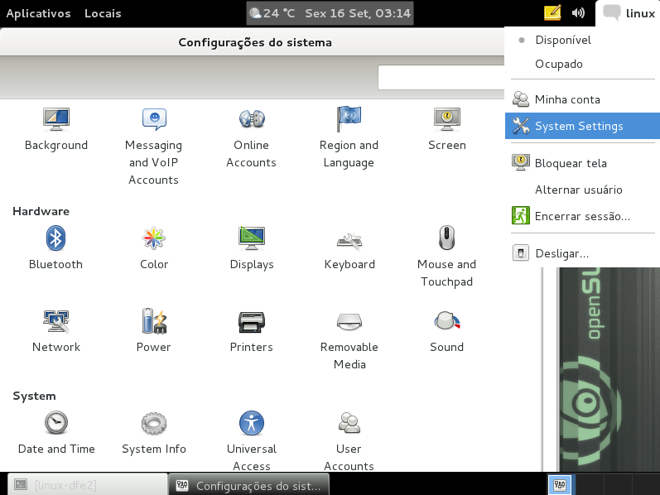

Slide 19

KDE
Version KDE 4.7
New Instant Messaging integrated directly into desktop
Updated KDE Applications Bring Many Exciting Features
  Dolphin – Default appearence clean
  Marble – Voice navigation
  Gwenview – Possibility to compare two images side by side
  Digikam – Face detection, geotagging, versioning and more images

Slide 20
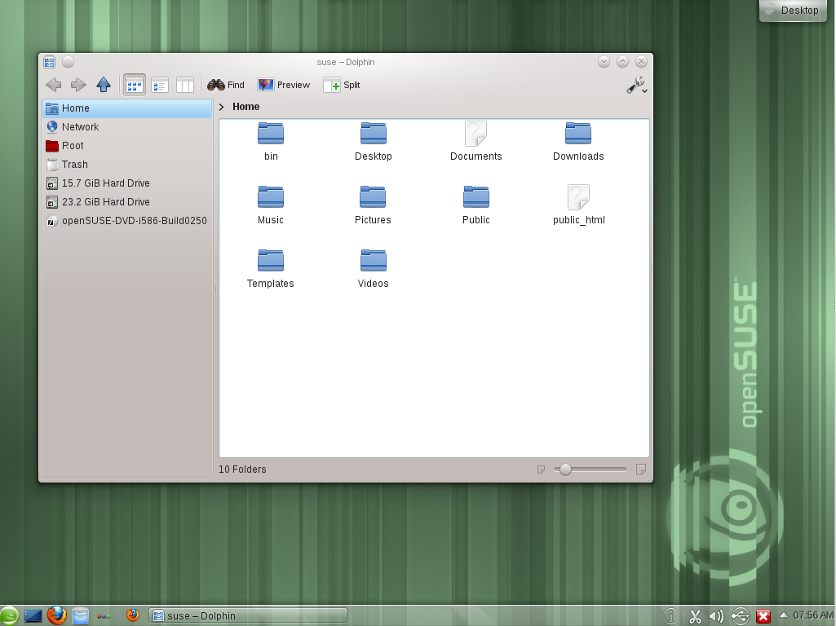

Slide 21
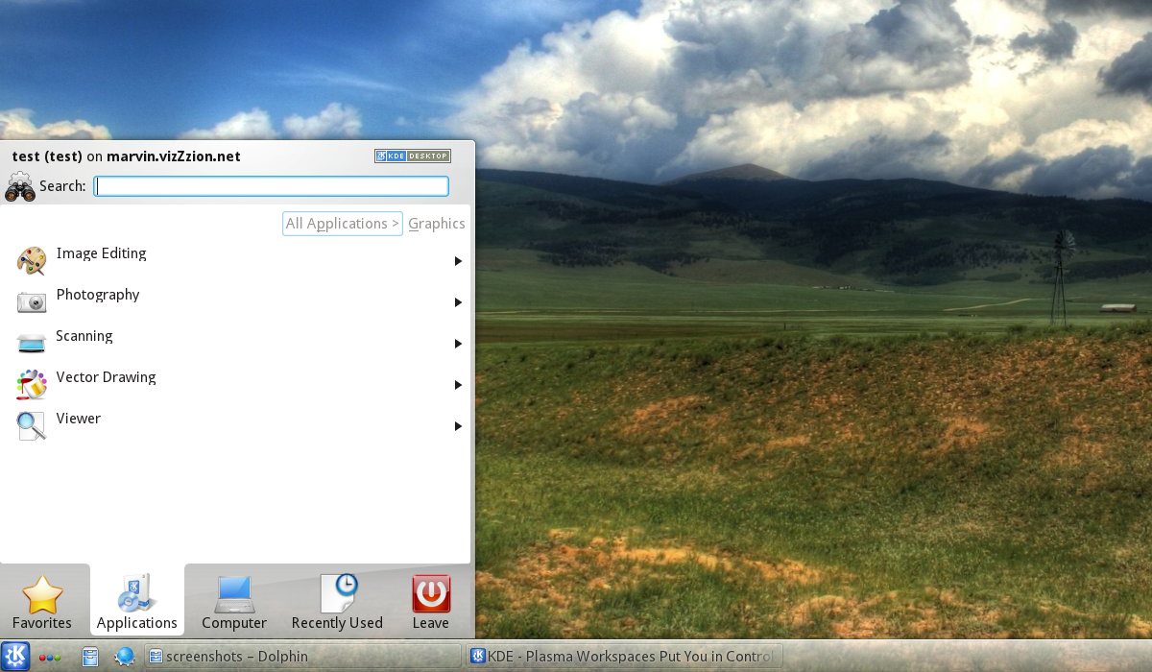
KDE 4.7 Menu

Slide 22
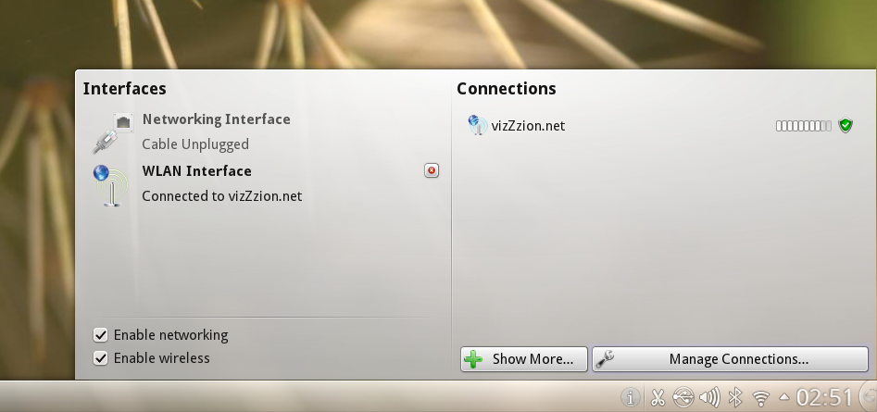
KDE 4.7 Plasma NetworkManagement

Slide 23

LXDE
Versão LXDE 0.5.5
Light
simplicity
Faster!
Economic
Easy to use!

Slide 24
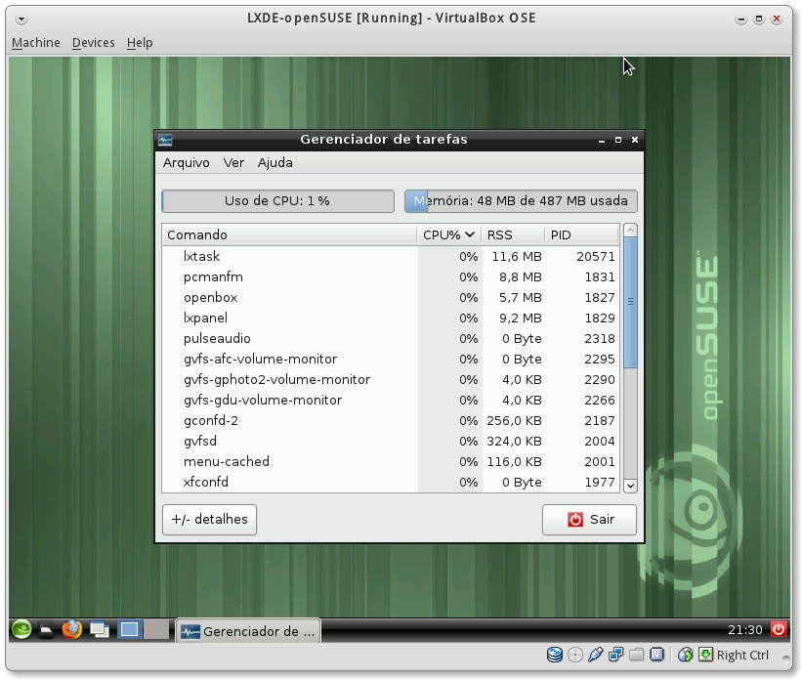
Outras Interfaces
LXDE 0.5.5

Slide 25
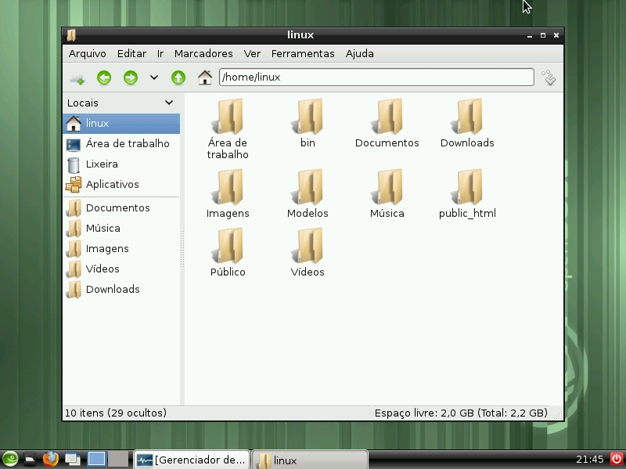

Slide 26

XFCE
XFCE 4.8.2!
Alternative to GNOME
Low consuption of RAM
Intuitive interface

Slide 27
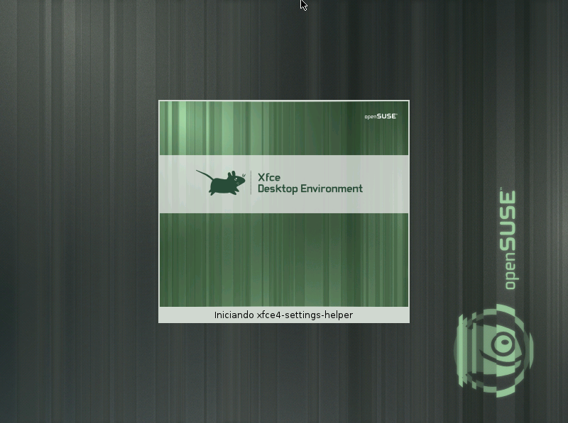

Slide 28
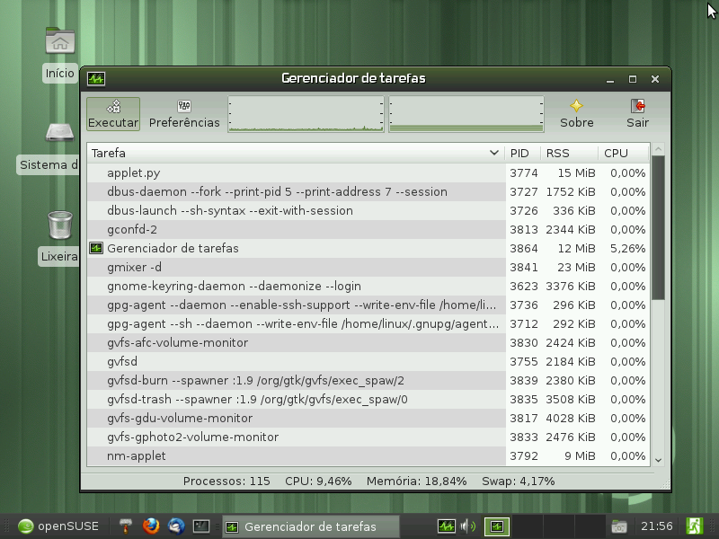

Slide 29
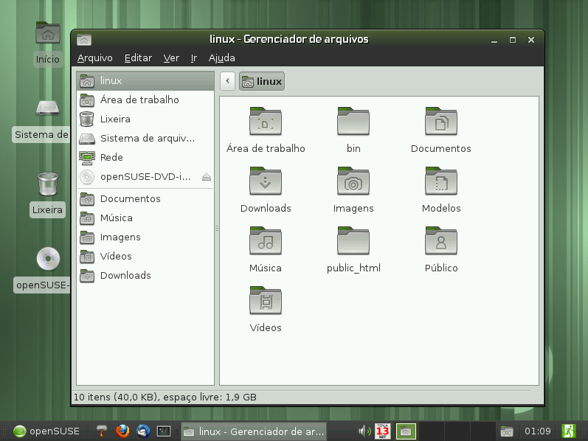

Slide 30
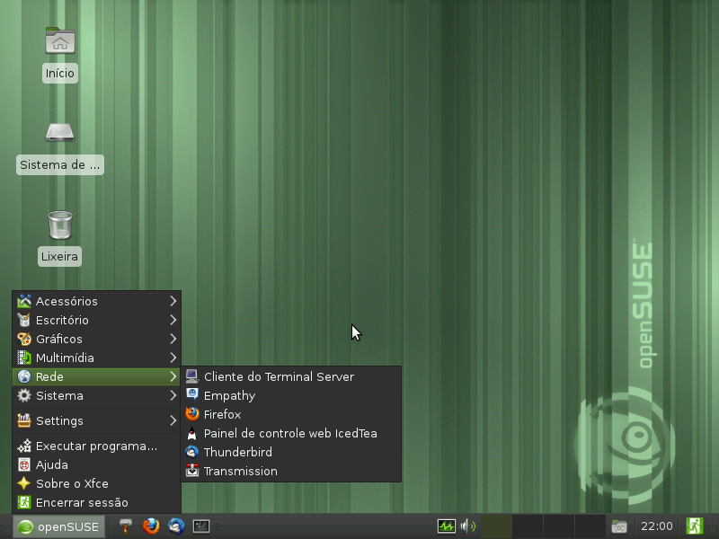

Slide 31
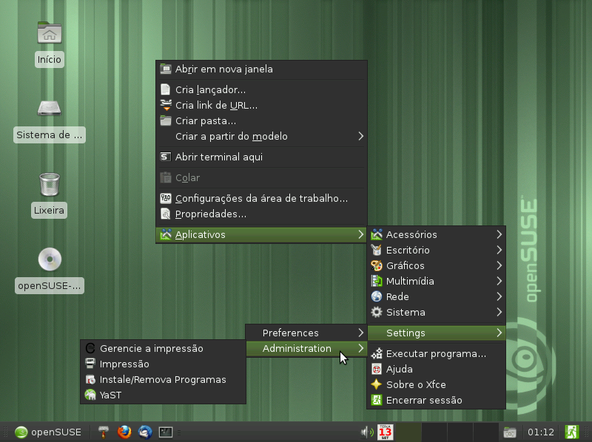

Slide 32
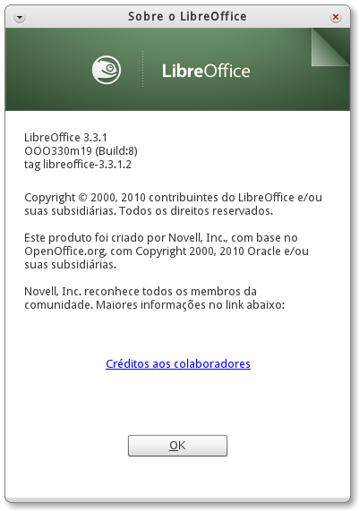

Be a productive!!!
With LibreOffice 3.3.1, create documents, spreadsheets and presentations
Manage their finances
Keep informed and plan your daily activities
Notes:
mention the cost savings of open office versus MS Office and yet features are very similar

Slide 33

Take control with YaST2
Network configurations
Hardware configurations
Manage users and groups
Set email notifications
Apply / Disable / configure services
Apply patches, updates and install new applications
Protect your applications with AppArmor
See the logs

Slide 34
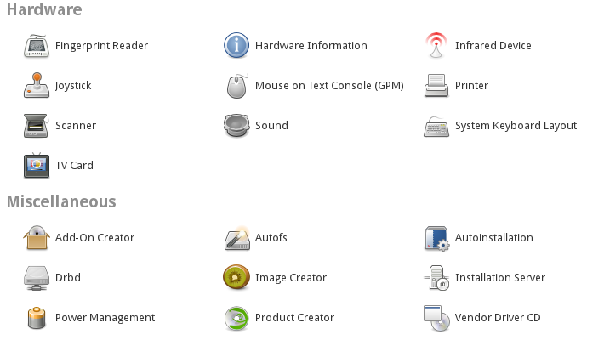
YaST

Slide 35
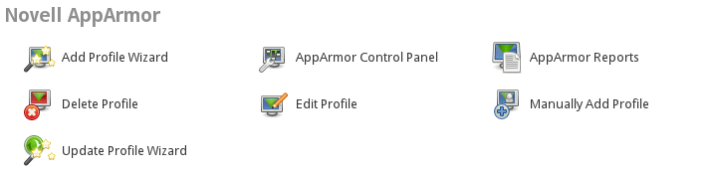
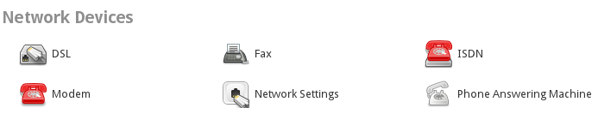
YaST

Slide 36
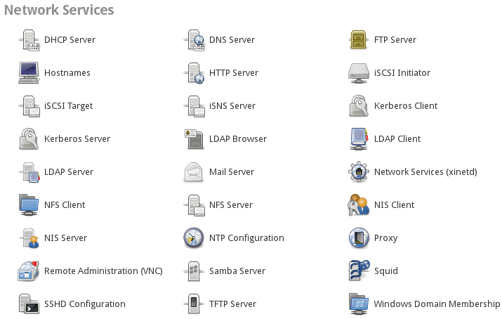
YaST

Slide 37
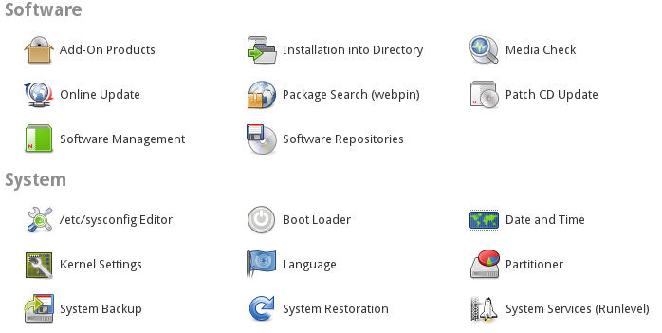
YaST

Slide 38
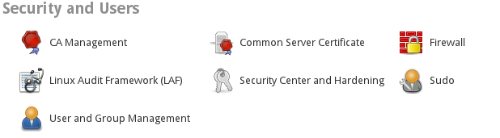
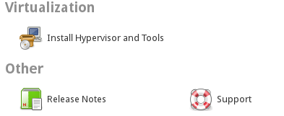
YaST

Slide 39

Gerencimanto Remoto
WebYaST
Remote Desktop

Slide 40

Security
Use the YaST2 to set security configurations
PolicyKit
AppArmor
Encryption of files and partitions
Use SSH for Secure Network Operations
SuSEFirewall
Easily set up a VPN server
Configure a proxy server
and much more!

Slide 41
What we offer
A stable system
  Have a lot fun!
Software produced with quality
  All packages are produced in the openSUSE Build Service
Active community
  Several channels of communication
  Quick answers
  We want to hear your problems!

Slide 42
Key communication channels
Forums
  Oficial: http://forums.opensuse.org/
Site – http://opensuse.org/
Wiki – http://en.opensuse.org/
IRC – freenode server
  #opensuse
  Full list: http://pt.opensuse.org/openSUSE:Lista_do_IRC
Mailing lists
  Project: opensuse-project@opensuse.org
  Marketing: opensuse-marketing@opensuse.org
  Factory: opensuse-factory@opensuse.org
  Full list: http://lists.opensuse.org/

Slide 43

Sugestions?
You have an idea?
Want to propose a change?
Want to know what will be the next big thing?
Go to openFATE
https://features.opensuse.org/

Slide 44
Questions?

Slide 45




Questions?

Slide 46

Muito Obrigado!

